Slide 1
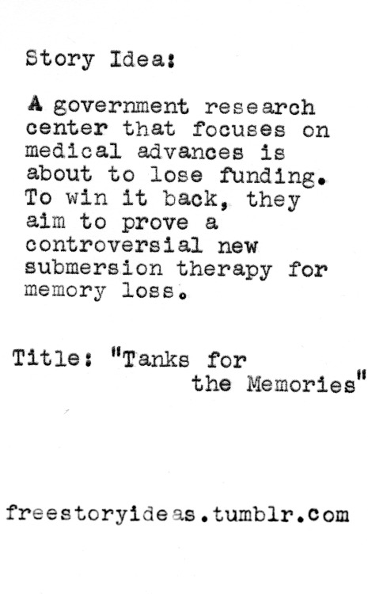

01
1 - Story Idea
A Pixar employee pithes their idea to other members of the development team. The real challenge is to get the audience to believe in the idea and see the possibilities in it.
Tecniche di animazione 3D Prof. Marcucci

Slide 2
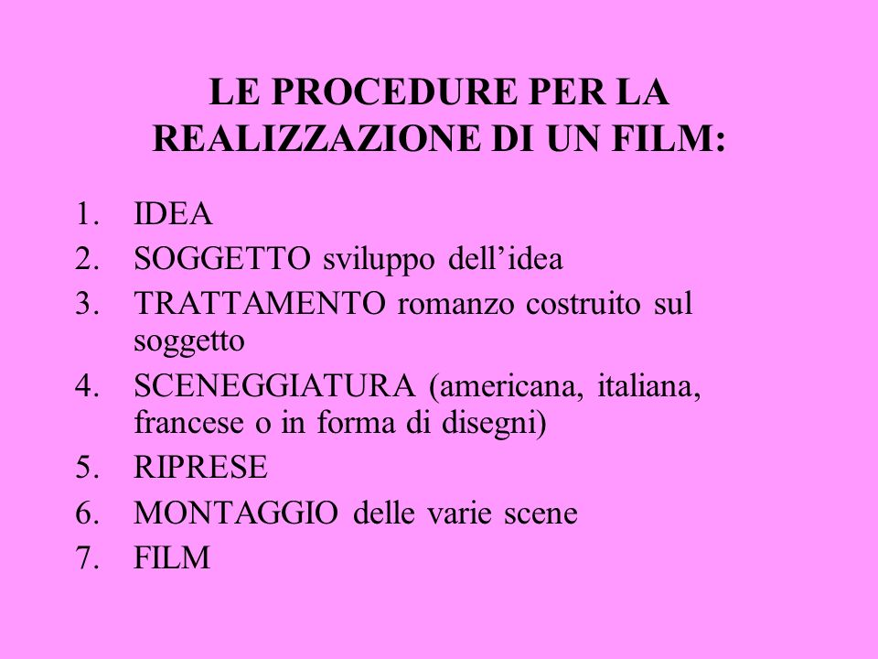
01
2 - Text Treatment
A treatment is a short document the summarises the main idea of the story. Sometime, many treatments of the same idea will be developed in order to find the right balance between solid ideas and open possibilities, which will be filled in later by development and storyboard artists
.
Tecniche di animazione 3D Prof. Marcucci

Slide 3
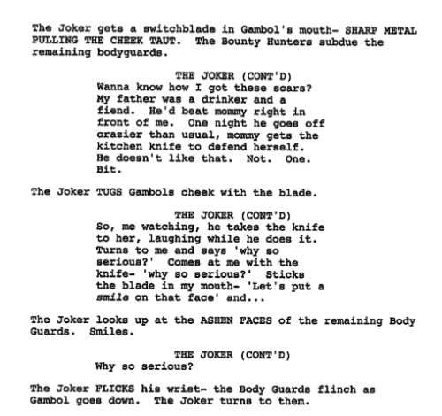
01
3 - Script
The script is written after the story idea and text treatment
Lo Script o sceneggiatura racconta tutto il film con descrizioni e battute dei personaggi
Tecniche di animazione 3D Prof. Marcucci

Slide 4
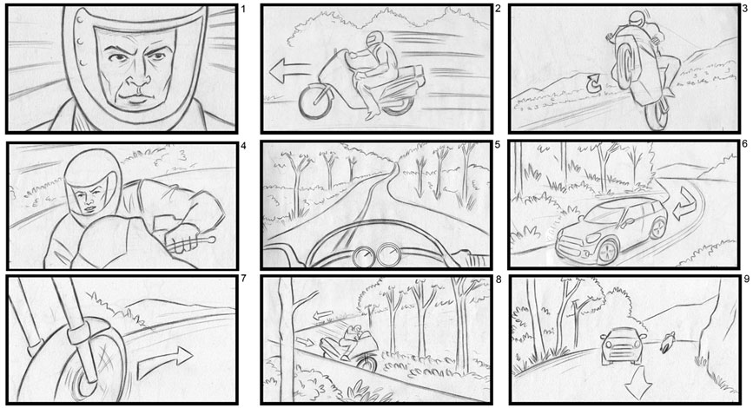
01
4 - Storyboard
Storyboards are like a hand-drawn version of the movie and serve as the blueprint for the action and dialogue. Each storyboard artist receives script pages and/or a "beat outline", a map of the characters' emotional changes that need to be seen through actions.
Using these as guidelines, the artists envision their assigned sequences, draw them out and then "pitch" their work to the director.
Tecniche di animazione 3D Prof. Marcucci

Slide 5
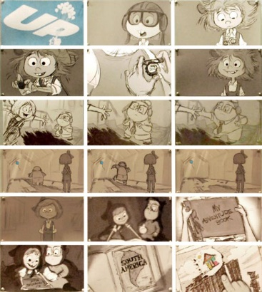
01
4 - Storyboard
A comic book version of the story. And we do it the way Walt Disney did it.
We have 4×8 sheets of bulletin board material, and we pin up drawings and we pitch them to each other. To see how things flow.
Because no matter all the great animation you can do will never save a bad story.
We’ll even slow the production down or stop production to get the story right because we believe that it’s the story that entertains audiences.
It’s not the technology. It’s not the way something looks. It’s the story.
Tecniche di animazione 3D Prof. Marcucci

Slide 6
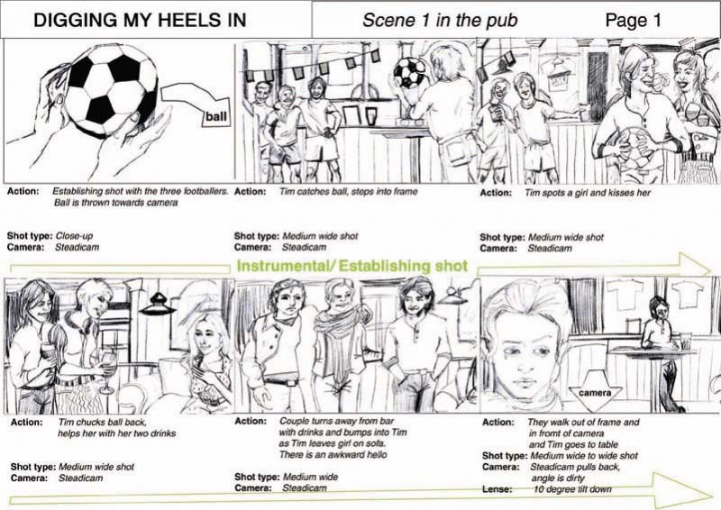
01
Tecniche di animazione 3D Prof. Marcucci

Slide 7
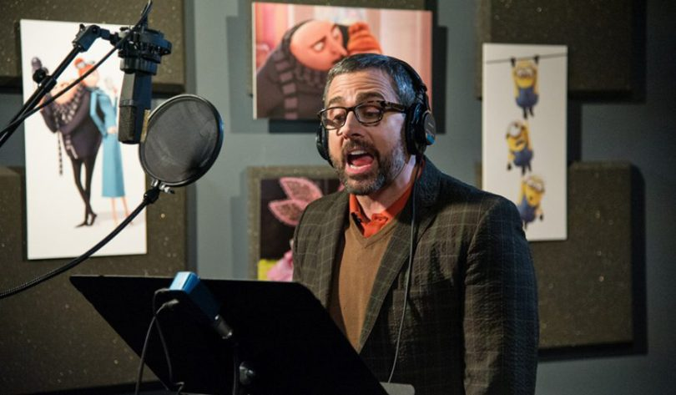
01
5 - Voice talent
First,
First, temporary "scratch" voices are recorded by pixar artists for the storyboard reels.
Later, when the story and dialogue are further along, professional actors begin recording the character voices, reading from a script and improvising.
Actors must record lines several different ways, and the best reading is eventually animated. sometimes, scratch voices are so good, they are not replaced.
Tecniche di animazione 3D Prof. Marcucci

Slide 8
01
6 - Reels
A reel is a videotape that allows the cleaned-up storyboard sequence to stand alone, without a pitch persaon to tell the story.
A pitch can be successful because the story teller is strong, so reels are an essential step to validate the sequence and are the first instance that the "timing" of the sequence is understood.
Editorial uses the information to fix the length and other elements of each shot in a sequence.
Tecniche di animazione 3D Prof. Marcucci

Slide 9
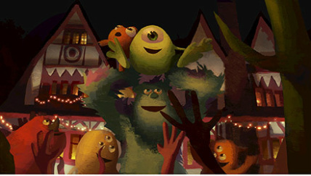
01
7 – Look and feel
Based on the initial text treatment, storyboards and their own creative brainstorming and development work, the art department creates inspirational art ilustrating the world and the characters.
It also designs sets, props, visual looks for surfaces and colours and "colour scripts" for lighting, which are impressionistic pastel illustrations that emphasize the light in screens. The art department designs all the characters, major set locations, props and colour palettes for the film.
Tecniche di animazione 3D Prof. Marcucci

Slide 10
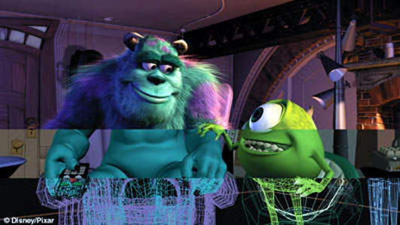
01
8 – models
the characters, sets and props are either sculpted by hand and then scanned in three dimensionally or modelled in three-dimensions directly in the computer.
Since these are 3D objects, they're modeled on the X, Y and Z axes and can be rotated and viewed from any angle. When you first begin to model an object, it doesn't have any surface color or texture. All you see on your screen is the object's skeleton -- the lines and outlines of the individual cubes, blocks and spheres that have been used to construct it. This is called a wireframe.
The models are then give "avars", or hinges, which the animator will use to make the object or character move. For example, Woody has 100 avars in his face alone.
Tecniche di animazione 3D Prof. Marcucci

Slide 11
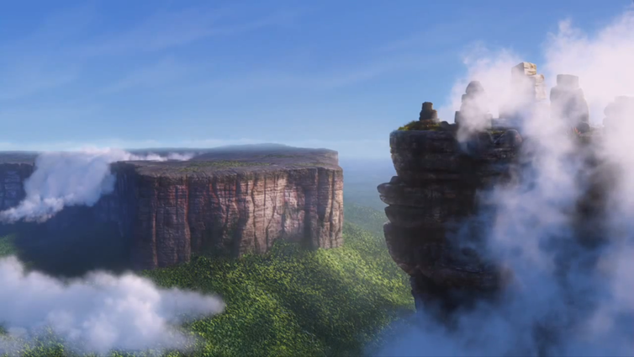
01
9 – Sets
Sets are environments created for the film's story.
Tecniche di animazione 3D Prof. Marcucci

Slide 12
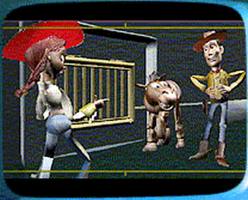
01
10 – Shots
Translating the story into three-dimensional scenes, the layout crew choreographs the characters in the set and uses a virtual camera to create shots that capture the emotion and story point of each scene. Layout often produces multiple versions of shots to provide the editorial department with choices for cutting the scene for maximum storytelling effect. Once the seen has been cut, the final version is released to animation.
Tecniche di animazione 3D Prof. Marcucci

Slide 13
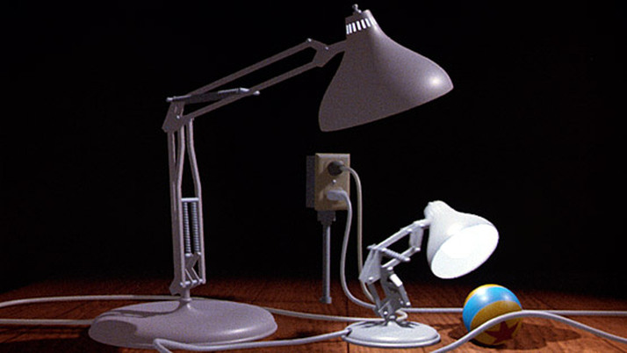
01
11 – Animation
Animators are like actors or puppeteers.
Pixar's animators choreograph the motion in each scene by defining key frames or poses. They do this by using computer controls and the character's avars to define key poses. The computer then creates the "in-between" frames, which the animator adjusts as necessary.
Tecniche di animazione 3D Prof. Marcucci

Slide 14
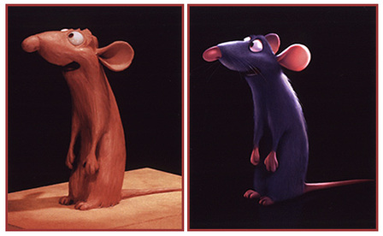
01
12 – Shade
The characters and props are given surface texture and color. They're dressed with clothing that wrinkles and flows naturally with body movements, hair and fur that waves in the virtual breeze, and skin that looks real enough to touch.
Tecniche di animazione 3D Prof. Marcucci

Slide 15
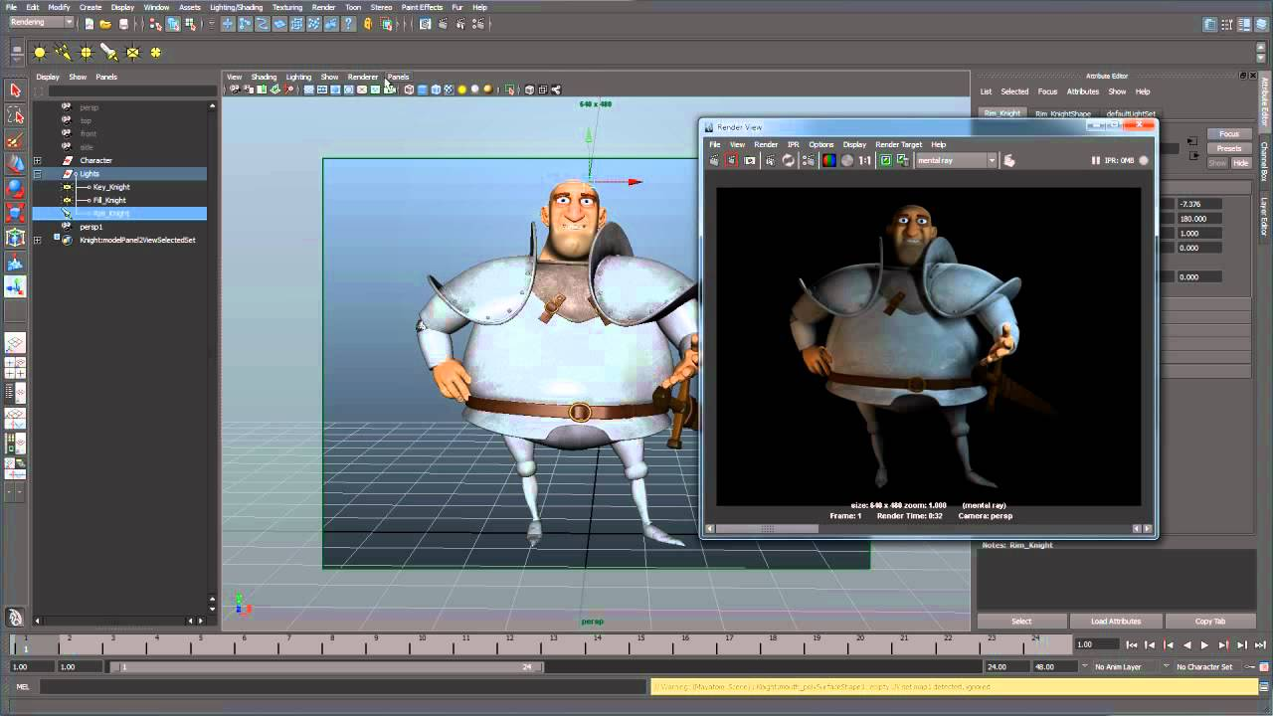
01
13 – Lighting
Using "digital light", every scene is lit in much the same manner as stage lighting. key, fill and bounce lights and room ambience are all defined and used to enhance the mood and emotion of each scene.
Tecniche di animazione 3D Prof. Marcucci

Slide 16

01
14 – Rendering
Rendering is the act of translating all of the information in the files that make up the shot, (sets, colours, character movement), into a single frame of film.
Pixar animated films are produced at a frame rate of 24 frames per second (fps). For a 90 minute film, that's nearly 130,000 frames of animation. At Pixar an individual animator is expected to produce 100 frames of animation a week.
Tecniche di animazione 3D Prof. Marcucci

Slide 17
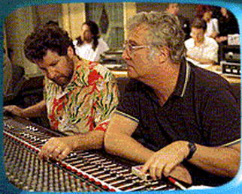
01
15 – Final touch and musical score
Editorial oversees the completion and addition of the musical score and the other sound effects. Effect animation adds special effects. and the photoscience department records the digital frame to film or to a form appropriate for digital production.
Tecniche di animazione 3D Prof. Marcucci

Slide 18
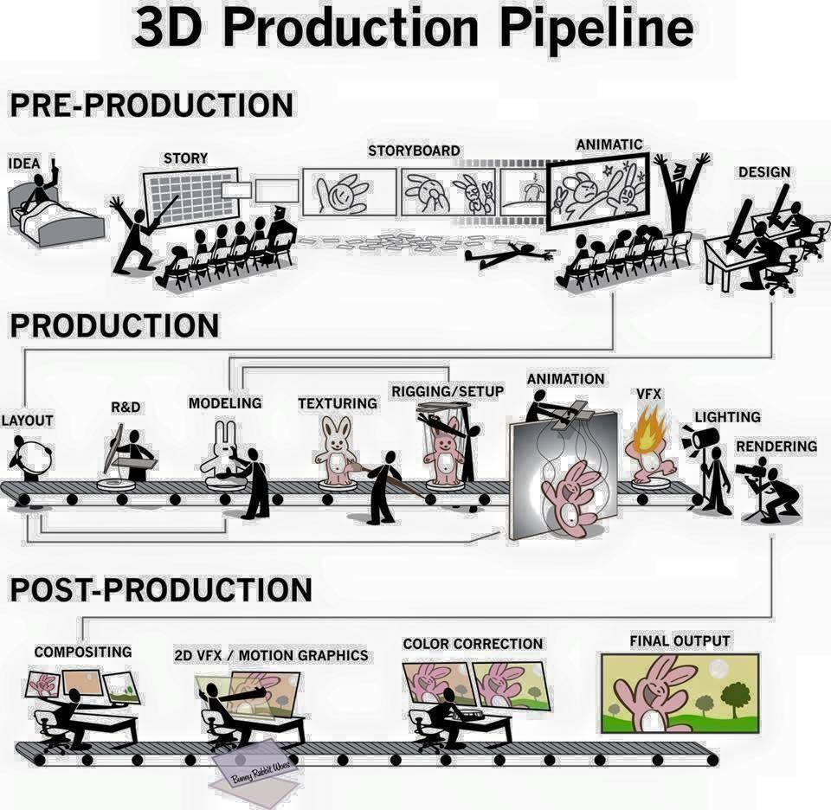
01
Riassumendo
Tecniche di animazione 3D Prof. Marcucci

